Slide 1

Bakeshop Themed Website
Mini Project 2 Presentation

Slide 2
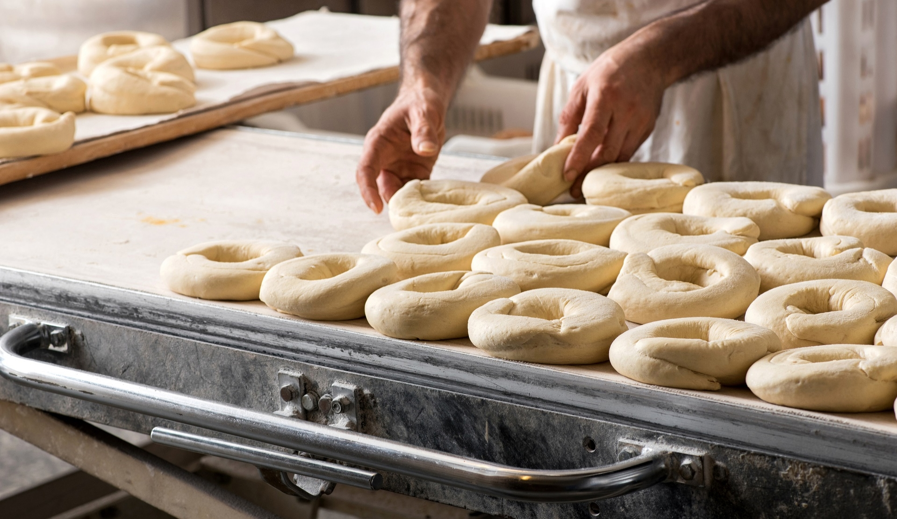

Concept
We decided to continue this project for its ecommerce concept which makes it more viable in the market when it comes to web development.

Slide 3

Agenda
The goal of this project is to provide the client with a responsive website for their own bakeshop business.
To give the client a website that will showcase their products in a pleasing manner to the customers.
To provide a simple and user friendly website for the customers that would patronize their business.

Slide 4









Technologies Used
Html
CSS
JavaScript
Bootstrap
Git Hub
Git Bash
Git Hub Pages
Snappa.com (for my banner and logo templates)
Favicon.cc
React

Slide 5



Summary
This website would greatly help to publicize and to introduce products to the public who are mostly into online purchase.

Slide 6
Team
Kriss Kevin Santos
Michael Pajo
John Patrick Valera

Slide 7

THANK YOU
Katrina’s
Bakeshop

